Slide 1
Diagram & Icon Library - Community 3 of 3
April 2012
These are the official icons and diagrams of VMware, Inc. VMware allows the use of these icons and diagrams in derivative works by VMware Community members to illustrate virtualization concepts and IT architectures only if the VMware copyright and terms of use are clearly displayed. The VMware icons and diagrams cannot be altered in any way. Please contact Christine Gemassmer cgemassmer@vmware.com with any questions or to request permission for commercial re-publication of the VMware icons and diagrams.
Please include the following statements on any derivative works created with the official VMware Icons and Diagrams:
This document was created using the official VMware icon and diagram library. Copyright © 2012 VMware, Inc. All rights reserved. This product is protected by U.S. and international copyright and intellectual property laws. VMware products are covered by one or more patents listed at http://www.vmware.com/go/patents.
VMware does not endorse or make any representations about third party information included in this document, nor does the inclusion of any VMware icon or diagram in this document imply such an endorsement.
Copyright © 2012 VMware, Inc. All rights reserved. This product is protected by U.S. and international copyright and intellectual property laws. VMware products are covered by one or more patents listed at http://www.vmware.com/go/patents.

Slide 2
VMware Logo

Slide 3
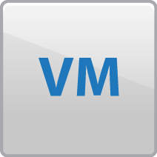
VMware vCenter Server
VMware vCenter Server
Manage
VMware vSphere
VMware vSphere
VMware vSphere

Slide 4
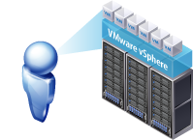
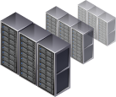
VMware vCenter Server
VMware
vCenter Server
Automation
Unlocks the power of VMware vSphere
through proactive
management
Visibility
Deep visibility into every level of the virtual infrastructure
Scalability
Scalable & Extensible management platform

Slide 5
VMware vCenter Orchestrator
vCenter Orchestrator
Client Application
Browse Access
Web Service
Workflow Engine
Workflow Library
vCenter
VI3
WMI
XML
SSH
JDBC
SMTP
3rd Party
Plug-In
Directory
Services
vCenter
Server
Orchestrator
Database

Slide 6
VMware vCenter Orchestrator
Task Management
Automated
Provisioning
Intelligent
Deployment
VM Tracking
Decommissioning
VMware vCenter Orchestrator

Slide 7
VMware vCenter HeartBeat
Heartbeat Diagnostics
Fully Monitored Redundancy Framework (Heartbeat)
PRIMARY SERVER
SECONDARY SERVER
vCenter Server
WAN
vCenter Server
Application
Management Framework
MONITORING
REPLICATION
FAILOVER
SWITCHBACK
ROLLBACK
Data
Data
OS
LAN
OS
HEARTBEAT CHANNEL
+
Persistent Connection Layer
P2P, P2V, or V2V FAILOVER

Slide 8
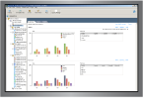
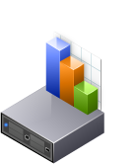
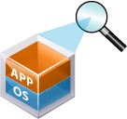
VMware vCenter CapacityIQ Overview
Analysis Engine
Capacity Dashboard
VM Profiling
Capacity Modeling
Virtual Datacenter
Capacity Plan
Shipped as a
Virtual Appliance
vCenter Server
Database
CapacityIQ Database

Slide 9
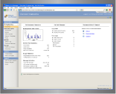
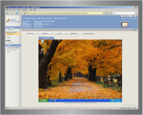
VMware vCenter Lab Manager Overview
Web Browser
Lab Manager Server
IT
Administrator
Portal
VM Configuration
Library
Workspaces
Web Browser
User Quotas
Roles & Rights
App Owners,
Dev & QA,
Support,
Training,
Demos
Self-Service
Portal
API
vCenter Server
Database
Lab Manager
Database
3rd party
Tools

Slide 10
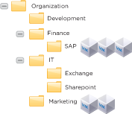
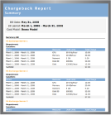
VMware vCenter Chargeback Overview
vSphere Client
vCenter Chargeback
Cost Configuration
Web Browser
Cost Modeling
Chargeback Hierarchy
vCenter Server
Database
API
Reports/Bills
Chargeback
Database
3rd Party
Tools
VMware
vCloud Director

Slide 11
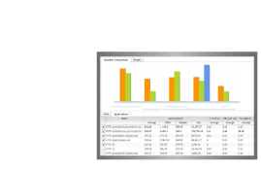
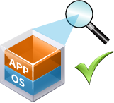
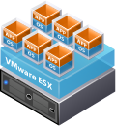
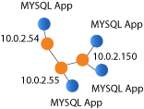
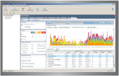
vCenter AppSpeed Overview
AppSpeed Server
View datacenter &
application-level
reports and dashboard
Discovers & Maps
Monitors Performance
vs. SLAs
Dive into specific tiers,
transactions, DB tables
and queries
Shipped as a
Virtual Appliance
vCenter Server
Database
AppSpeed
Database

Slide 12
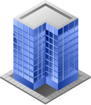
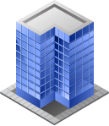
VMware vCenter Site Recovery Manager
VMware vSphere
Site A (Primary)
Site B (Recovery)
VMware
vCenter Server
Site Recovery
Manager
VMware
vCenter Server
Site Recovery
Manager
VMware vSphere
VMware vSphere
Servers
Servers

Slide 13
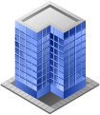
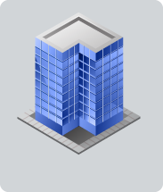
VMware vCenter Site Recovery Manager
Site 1
Site 2
SMB Shared Recovery Site
Site 3

Slide 14
VMware Server
VMware vSphere
VMware Server
Windows or Linux OS

Slide 15
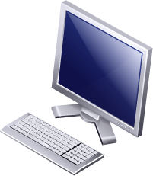
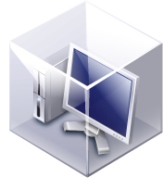
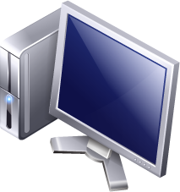
VMware View
VMware vSphere
User Experience
Virtual Desktop
OS, Data, Apps
Thin Client
OS, Provisioning
& Update
Desktop
User Data &
Personalization
Desktop VM
• Disaster Recovery
• Security
• Availability & Backup
Laptop
Application
Virtualization

Slide 16
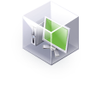
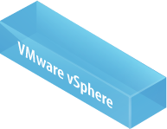
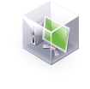
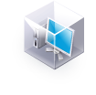
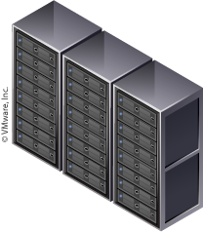
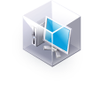
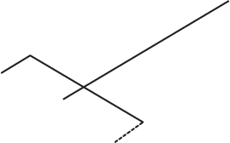
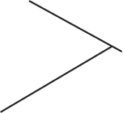
VMware View
Centralized Virtual
Desktops
Linked
Clones
Platform
VMware vSphere
For Desktops
Management
VMware View Manager,
VMware View Composer,
VMware ThinApp
VMWARE
VIEW MANAGER
Parent
Image
Thin Client
Desktop
VMWARE
VIEW
COMPOSER
User Experience
PCoIP, Print,
Multi-Monitor Display,
Multimedia,
USB Redirection,
Local Mode
Local
Mode
VMWARE
THINAPP

Slide 17
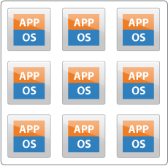
VMware View
TRADITIONAL VDI
VMWARE VIEW COMPOSER
Linked
Clones
Parent
Image
VMWARE
THINAPP
VMWARE
VIEW
COMPOSER

Slide 18
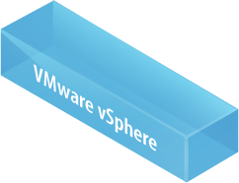
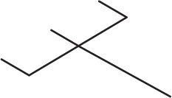
VMware View
VMware View Manager
Unified Access
Blade
PCs
Terminal
Servers
Physical
PCs
VMWARE
VIEW
MANAGER

Slide 19
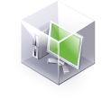
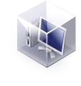
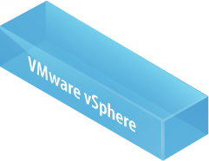
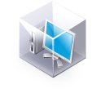
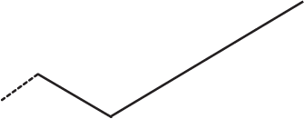
VMware View
Centralized Virtual
Desktop
Offline Desktop
VMWARE
VIEW
MANAGER
Offline
Desktop

Slide 20
VMware ThinApp
Sales &
Executives
Partners &
Contractors
VMware ThinApp
Physical PC
ACE or
Standalone
Knowledge
Workers
Blade PC or
Network Share
VDI or
Thin Client

Slide 21
VMware ThinApp
VMware vSphere
User Experience
Virtual Desktop
OS, Data, Apps
Thin Client
PERSONA
User Data &
Personalization
THINAPP
Desktop
Application
Virtualization
• Flexibility
• Security
• Availability
VOS
Laptop
Provisioning & Update

Slide 22
VMware ThinApp Elements
PERSONA
VOS
THINAPP
DATA
SANDBOX
VOS

Slide 23
VMware Studio
Configure,
Package,
Update
VMware Studio
Validate
VMware Ready
Manage
VMware
vSphere 4
Virtual Appliance
Distribute,
Discover
Virtual Appliance
Marketplace
Host as Service
VSPP

Slide 24
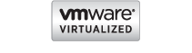
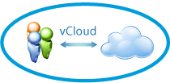
VMware vCloud
VMware vCloud
vCloud Technology
vCloud APIs
VMware Ready Cloud Services
Service Partner Ecosystem
Hundreds of Partners
Broad Application Support
vApps
Virtual Appliances
Cloud OS
Allocation
Aggregation
Abstraction

Slide 25
Flexible Cloud Deployment Models = Choice
Hybrid Cloud
APP
Loads
APP
Loads
APP
Loads
Management
Management
VMware vSphere
VMware vSphere
Private Clouds
Public Clouds

Slide 26
VMware vCloud Director
Organization 1
Organization m
Users
IT
VMware vCloud Director
User Portals
Catalogs
Security
Public Clouds
VMware vCloud API
Virtual Datacenter 1 (Gold)
VMware vShield
Virtual Datacenter n (Silver)
Programmatic
Control and
Integrations
VMware
vCenter Server
VMware
vCenter Server
VMware
vCenter Server
VMware vSphere
VMware vSphere
VMware vSphere
Secure Private Cloud
Notes:
All icons separated out.

Slide 27
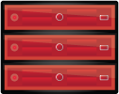
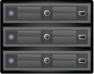
Desktop Solutions
VMware vSphere
Disaster Recovery
Virtual Desktops
Virtual Desktops
VMware vSphere
VMware vSphere
Servers
Servers

Slide 28
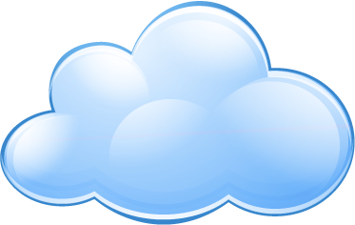
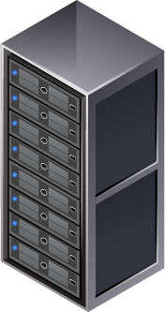
Desktop Solutions
Internal Cloud
Secure Managed Service
Local User
Offshore
User
Teleworker

Slide 29
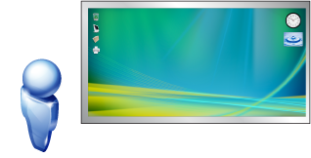
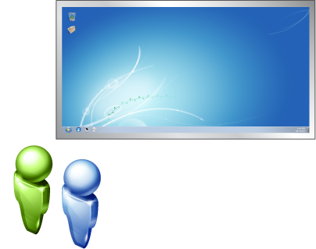
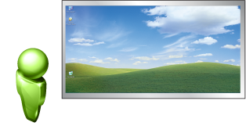
Desktop Solutions
OS Migration
OS Migration
Windows Vista
Windows 7
Windows XP

Slide 30
Desktop Solutions
App Migration
Develop Custom in-house apps, 3rd-party/vertical solutions and commercial apps.
Upgrade / Migrate Upgrade or migrate existing legacy apps without having to remediate code.
Upgrade
or Patch
VMware ThinApp Virtual OS Virtual Registry Virtual File System
Package Apps inside EXE and MSI files with no source changes.
Deploy Apps using existing management tools and infrastructure.
Test Apps against desktop Images and other apps with real-time diagnostics.
Notes:
Savings data came from the IDC study that VMware commissioned.

Slide 31
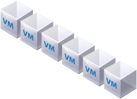
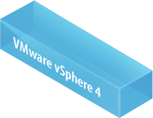
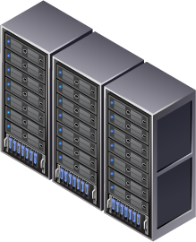
Desktop Solutions
ROBO - Centralized
Datacenter
Headquarters
Remote
Office
WAN

Slide 32
Desktop Solutions
ROBO - Distributed
Datacenter
Headquarters
Remote
Office
WAN

Slide 33
Desktop Solutions
Security & Compliance
Centralized Virtual
Desktop

