Slide 1
Diagram & Icon Library - Community 1 of 3
April 2012
These are the official icons and diagrams of VMware, Inc. VMware allows the use of these icons and diagrams in derivative works by VMware Community members to illustrate virtualization concepts and IT architectures only if the VMware copyright and terms of use are clearly displayed. The VMware icons and diagrams cannot be altered in any way. Please contact Christine Gemassmer cgemassmer@vmware.com with any questions or to request permission for commercial re-publication of the VMware icons and diagrams.
Please include the following statements on any derivative works created with the official VMware Icons and Diagrams:
This document was created using the official VMware icon and diagram library. Copyright © 2012 VMware, Inc. All rights reserved. This product is protected by U.S. and international copyright and intellectual property laws. VMware products are covered by one or more patents listed at http://www.vmware.com/go/patents.
VMware does not endorse or make any representations about third party information included in this document, nor does the inclusion of any VMware icon or diagram in this document imply such an endorsement.
Copyright © 2012 VMware, Inc. All rights reserved. This product is protected by U.S. and international copyright and intellectual property laws. VMware products are covered by one or more patents listed at http://www.vmware.com/go/patents.

Slide 2
VMware Logo

Slide 3
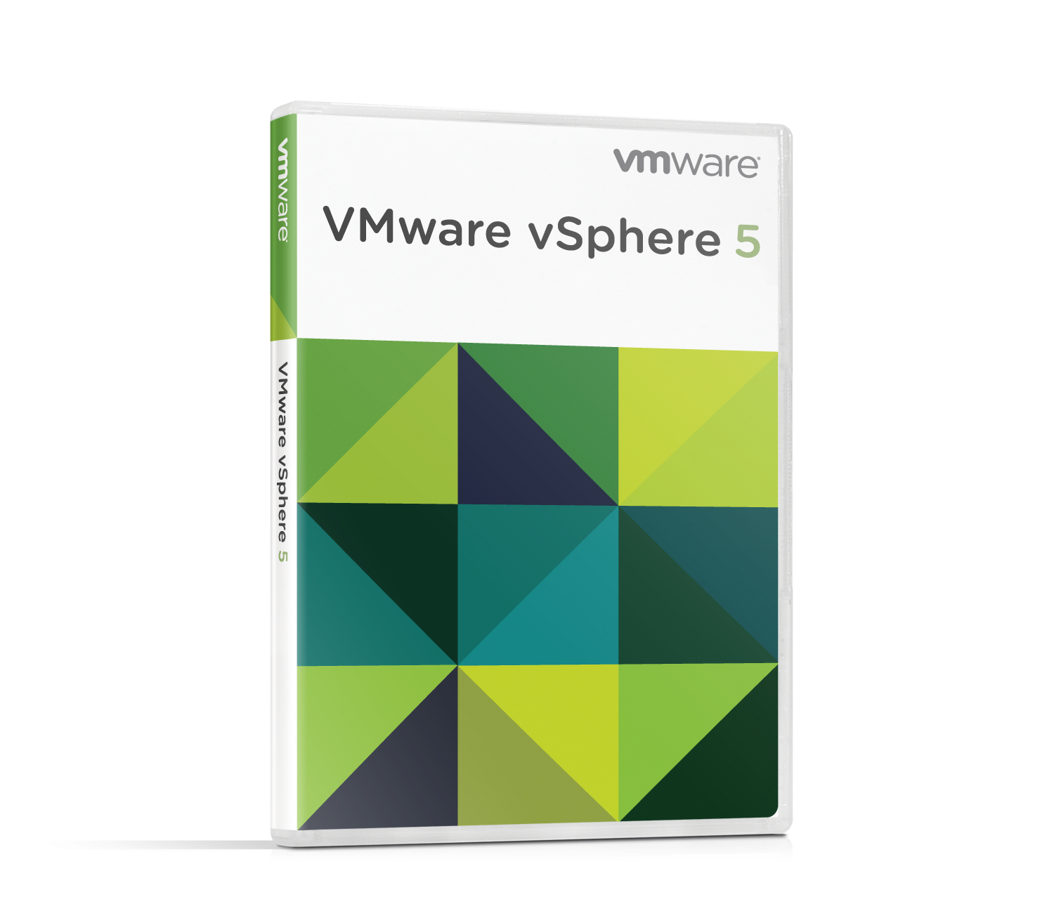
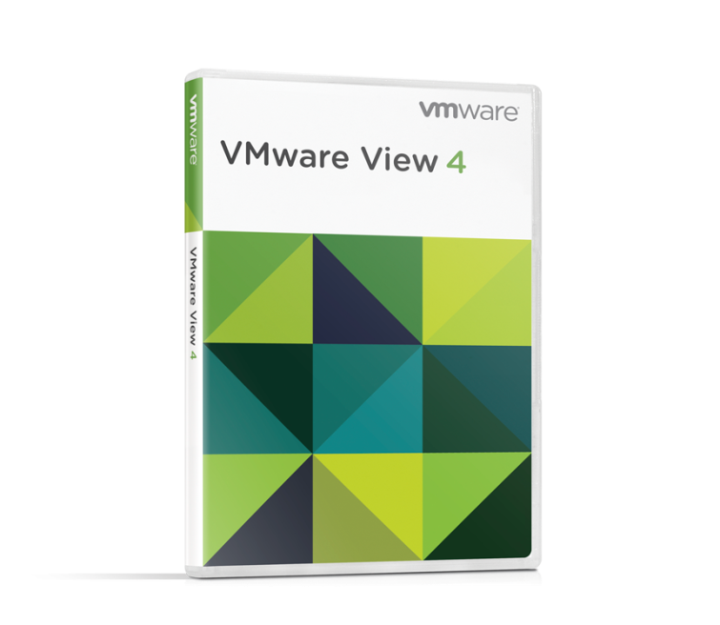
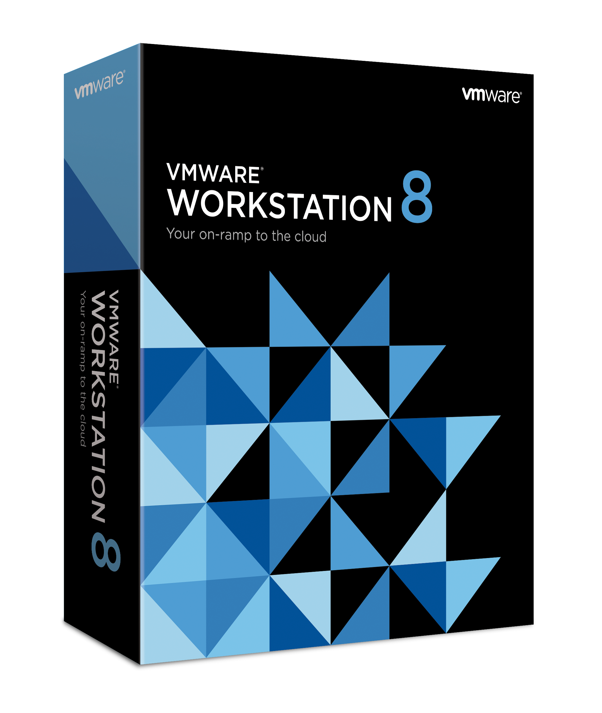
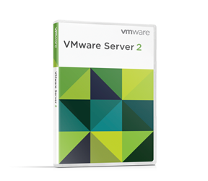
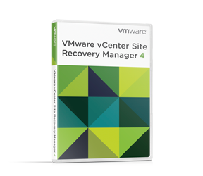
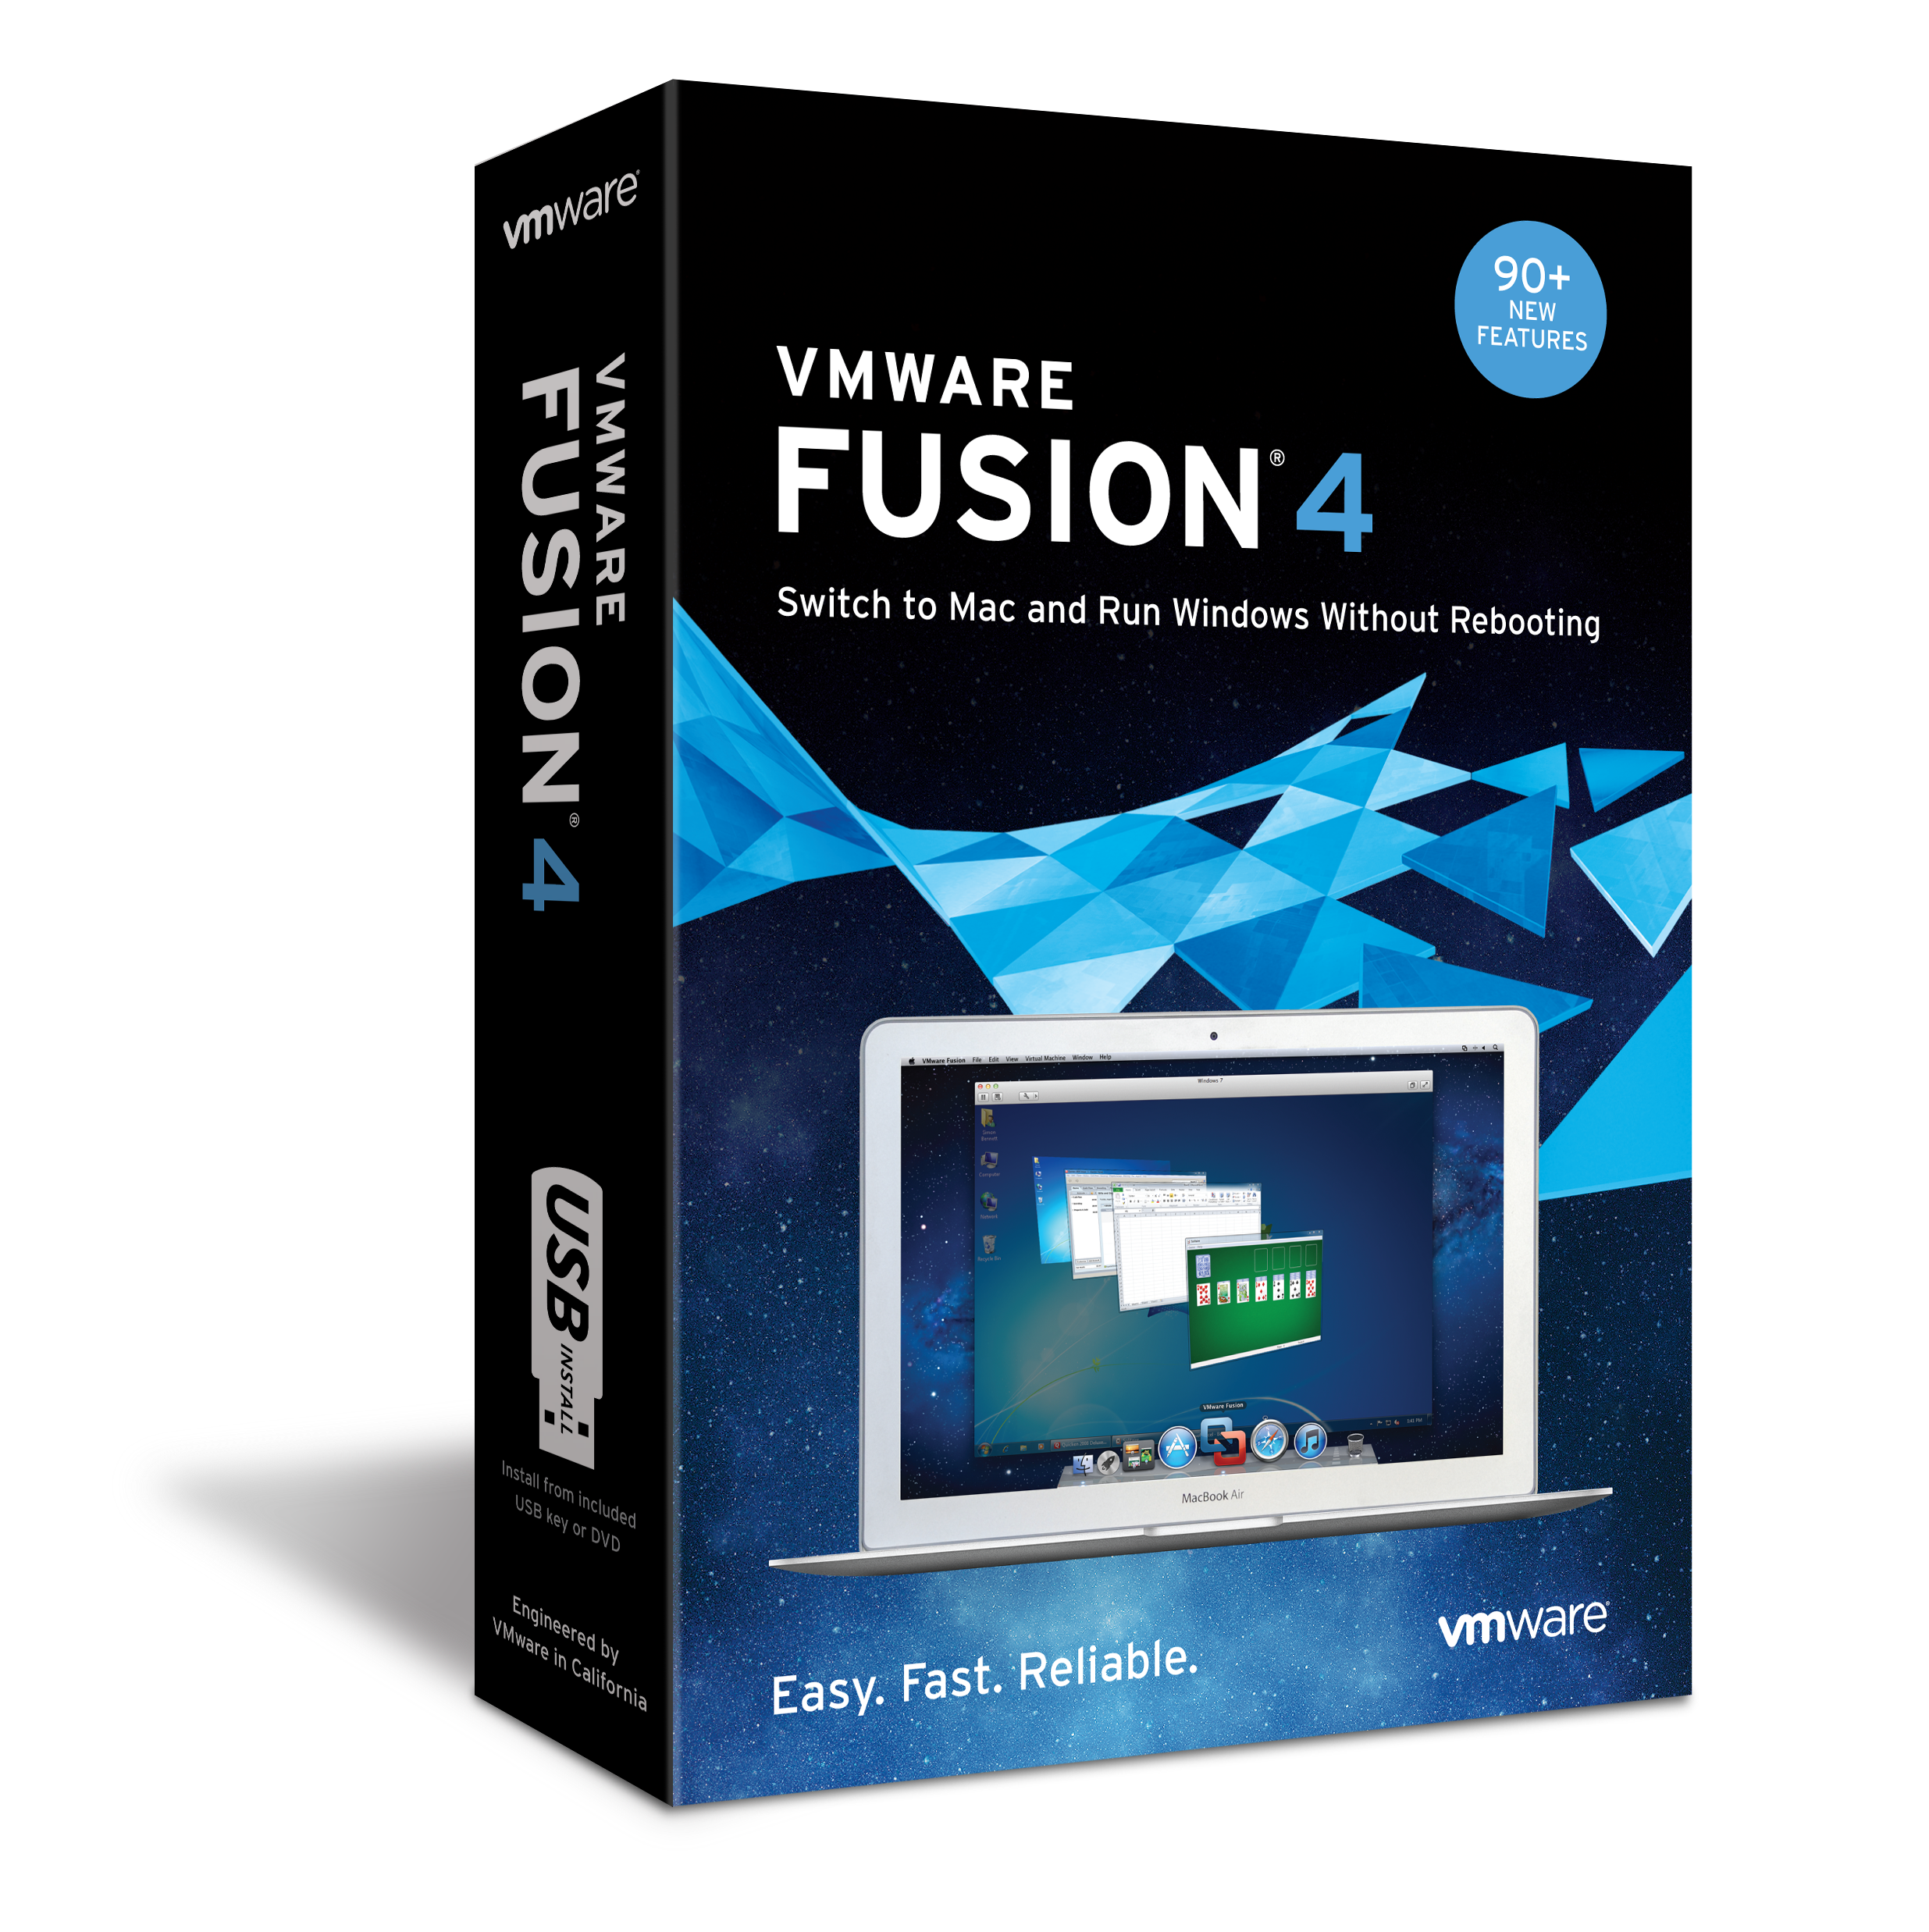
VMware Product Boxshots

Slide 4
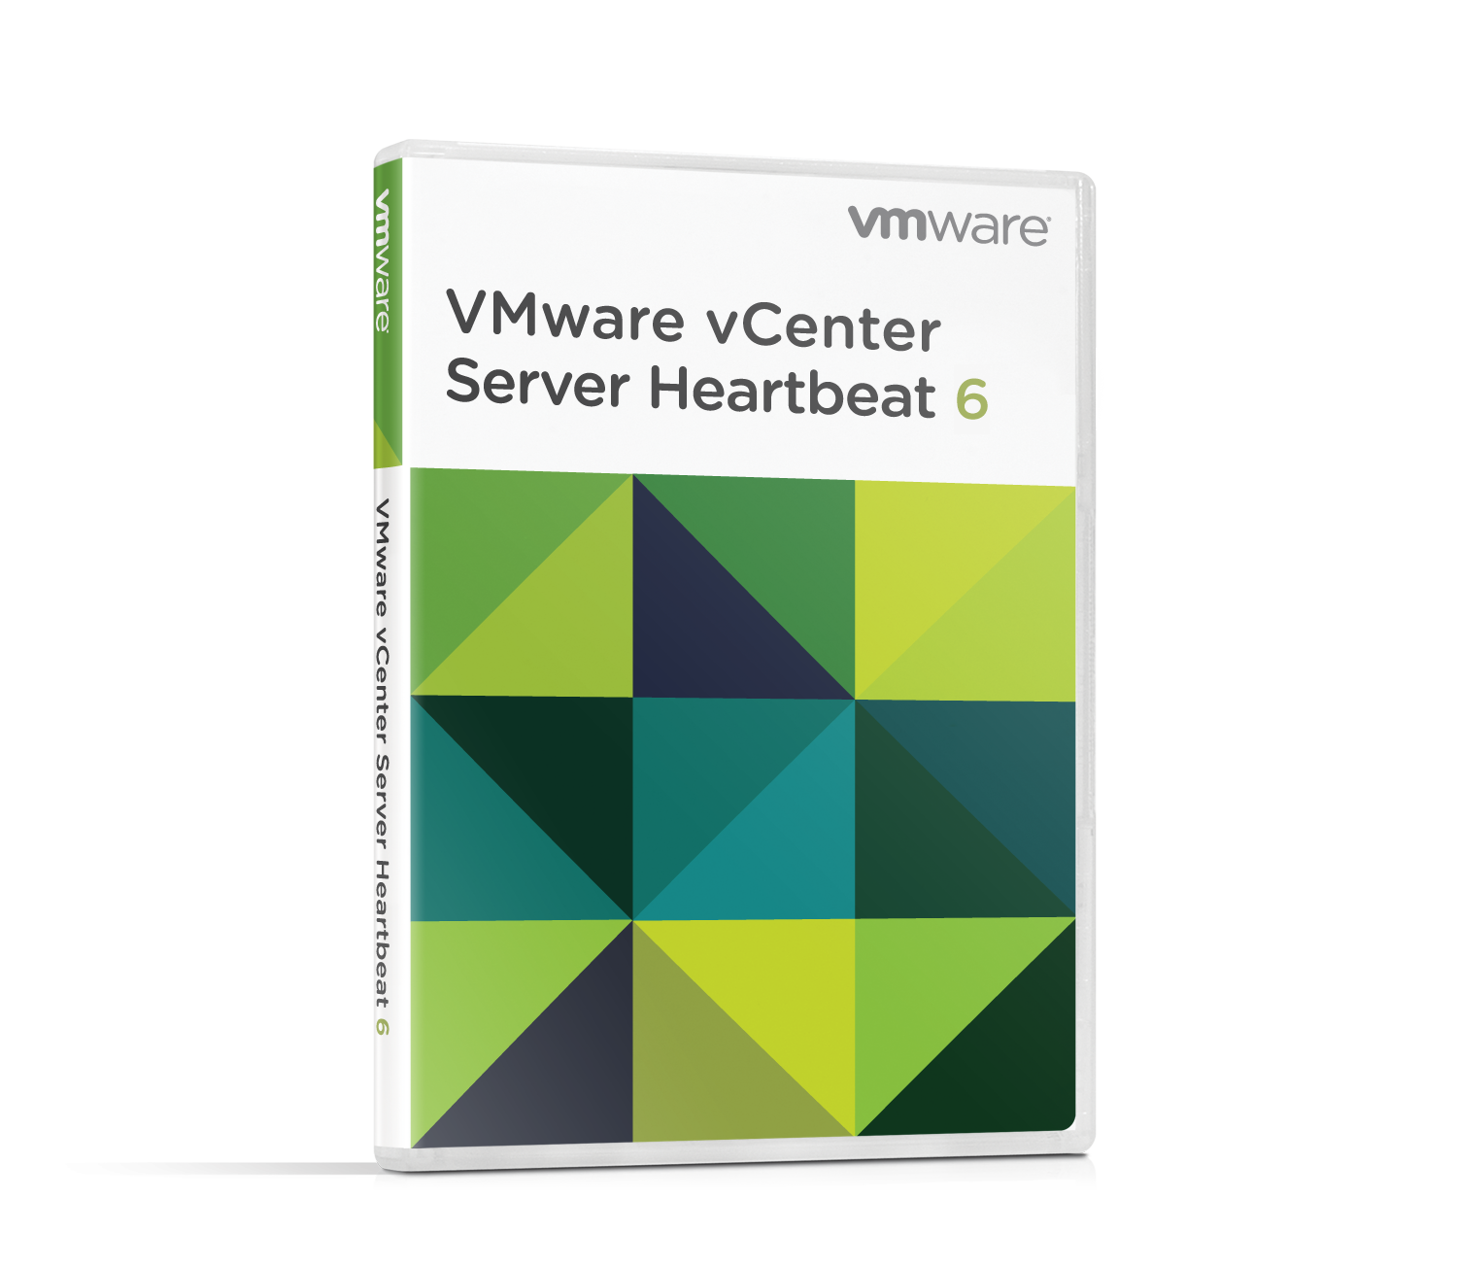
VMware Product Boxshots

Slide 5
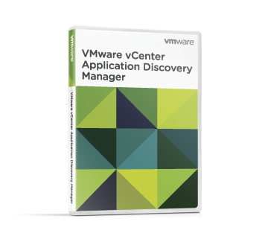
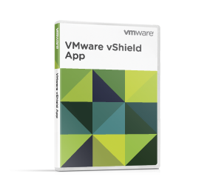
VMware Product Boxshots

Slide 6
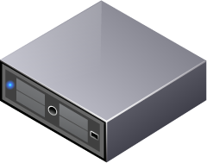
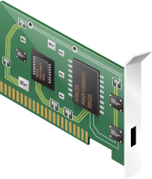
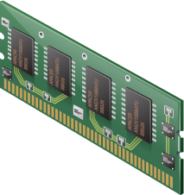
Icons
CPU
Hard Disk
NIC card
Rack Server
Memory card
Rack Server (failed)

Slide 7
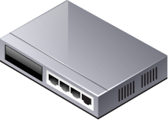
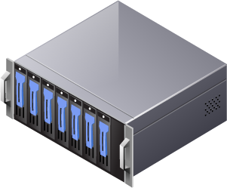
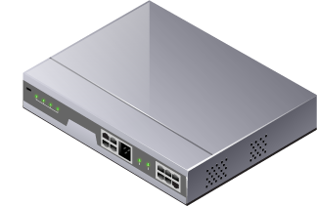
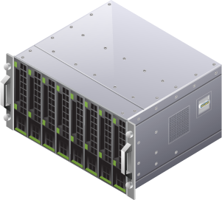
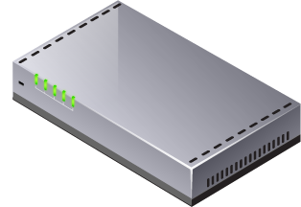
Icons
Network Switch (small)
Storage
Storage Array
Network Switch (large)
Blade Server
Router

Slide 8
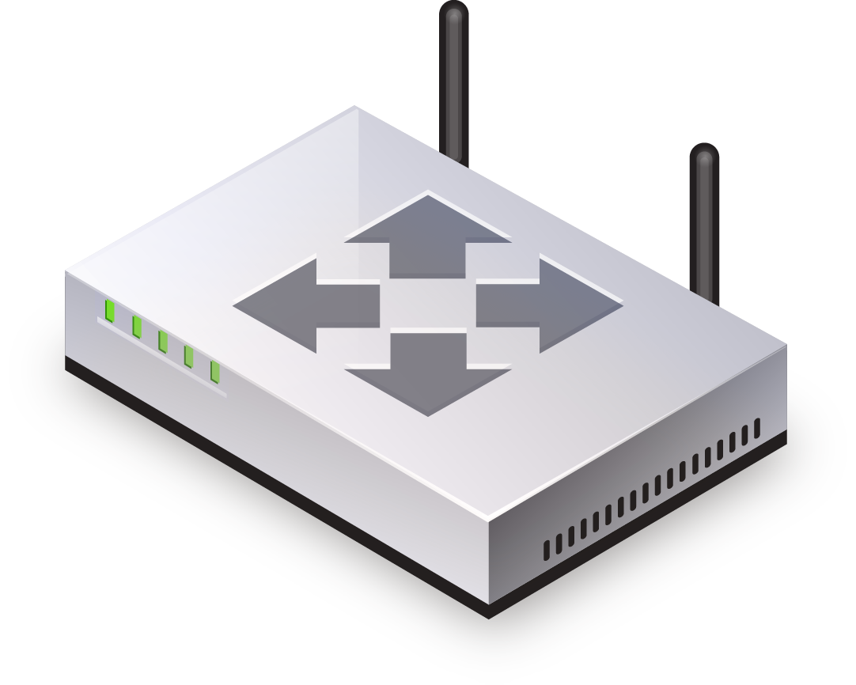
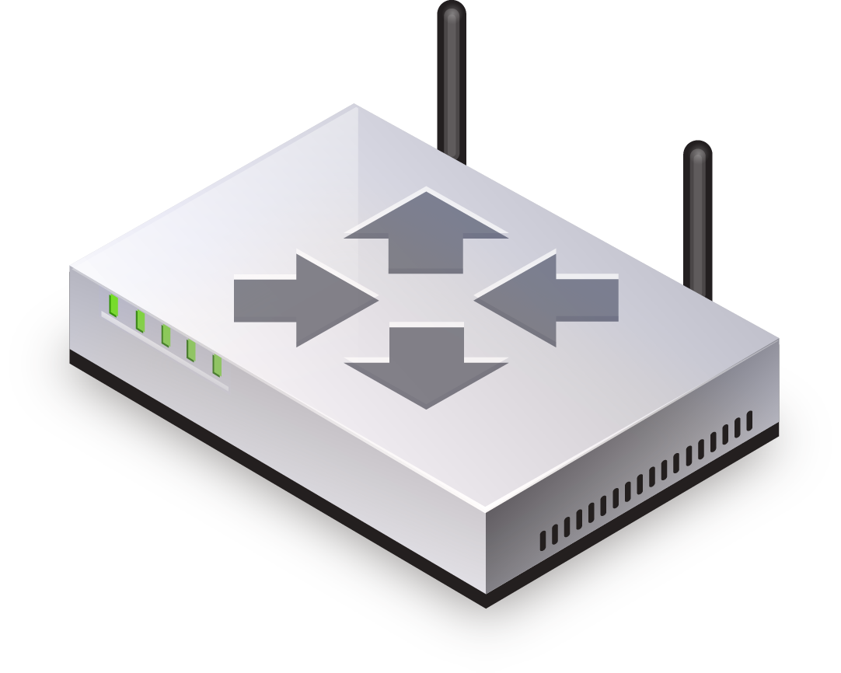
Icons
App Monitor
router 1
Server Monitor
router 2

Slide 9
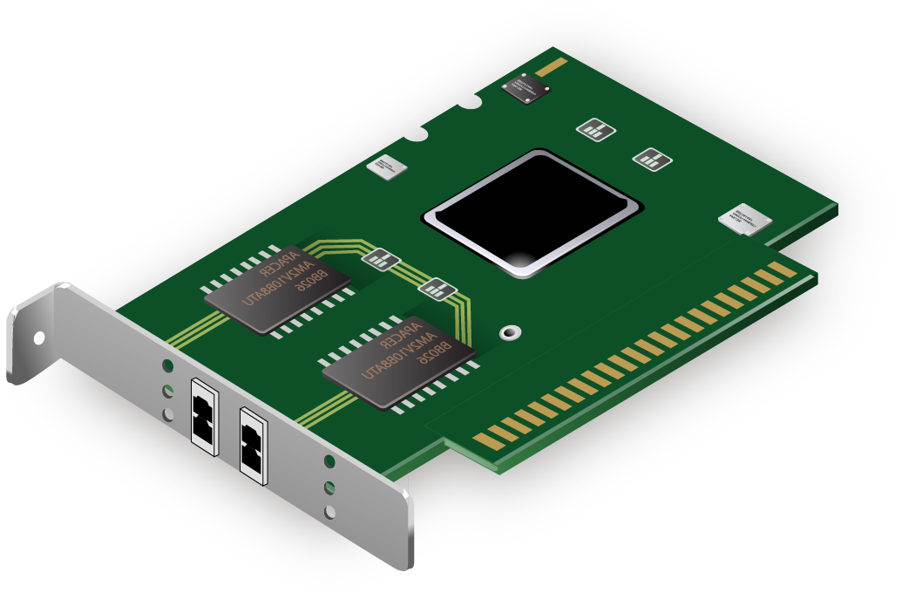
Icons
host bus adaptor
virtual switch
execution thread
memory ballooning
myonelogin

Slide 10
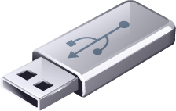
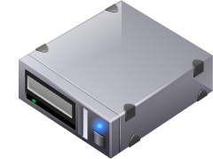
Icons
USB stick
Tape drive
CD/DVD
Generic PDA / Smart Phone
File Folder
Kiosk

Slide 11
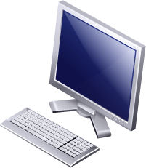
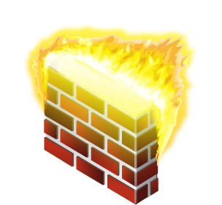
Icons
Laptop
Trash Can
Thin Client
Firewall
Desktop
Gear

Slide 12
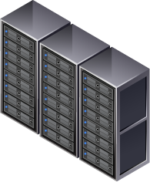
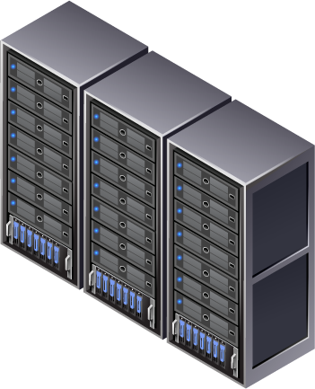
Icons
Datacenter
Datacenter with storage

Slide 13
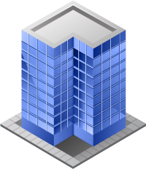
Icons
Security lock
Building
Multiple OS
Cloud
Script
Meter

Slide 14
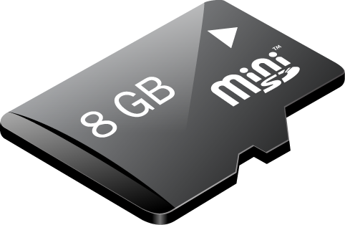
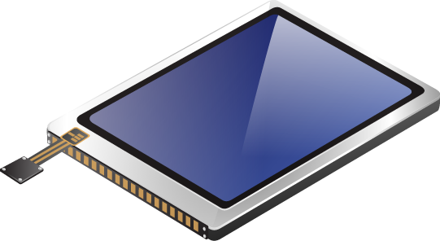
Icons
Mobile Antennae
Mobile Flash Memory
Mobile Keypad
Audio Speaker
SIM Card
LCD Touchscreen

Slide 15
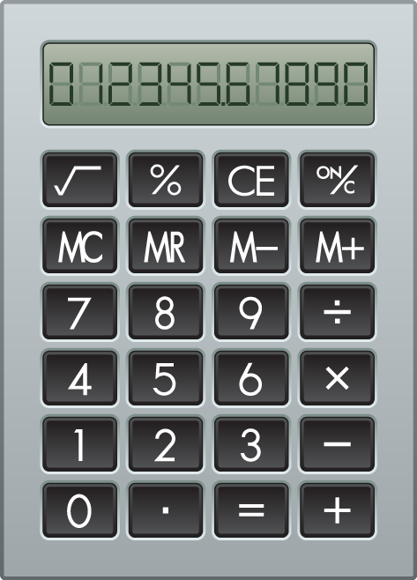
Icons
Plus Sign
Yen Sign
Dollar Sign
Calculator
Euro Sign
Clock

Slide 16
Icons
Award Seal
World
Cloud

Slide 17
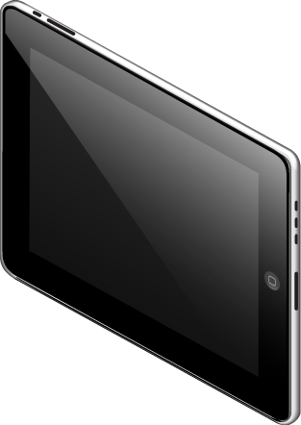
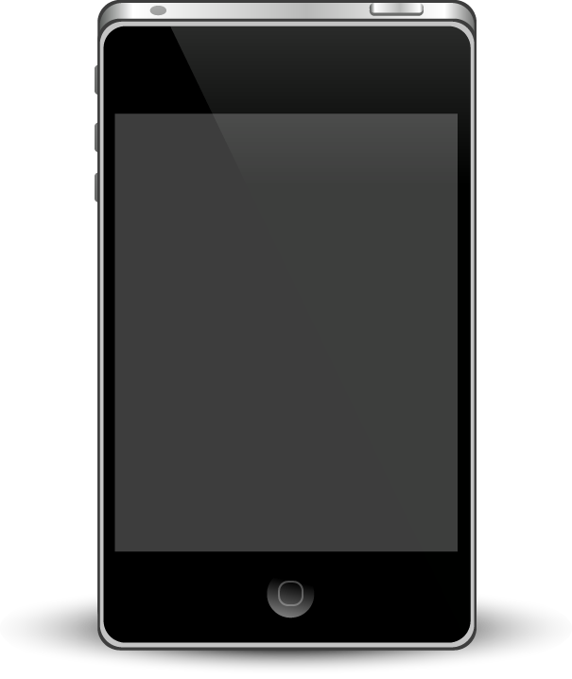
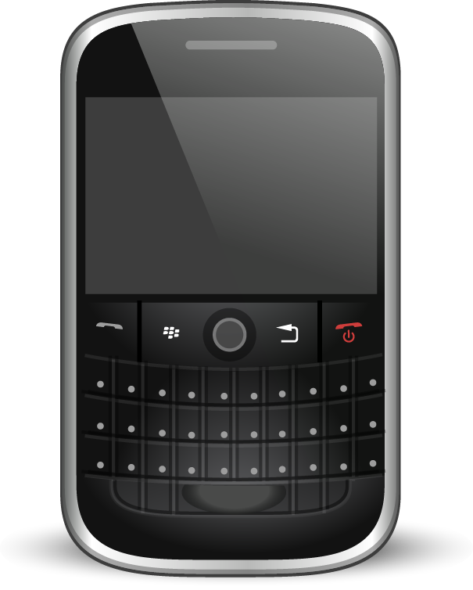
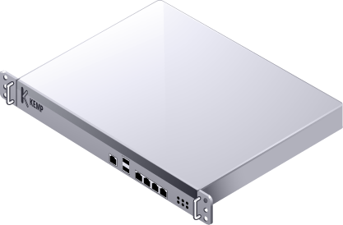
Icons
Shield
iPad
Anti Virus
iPhone
Load Balancer
Blackberry

Slide 18
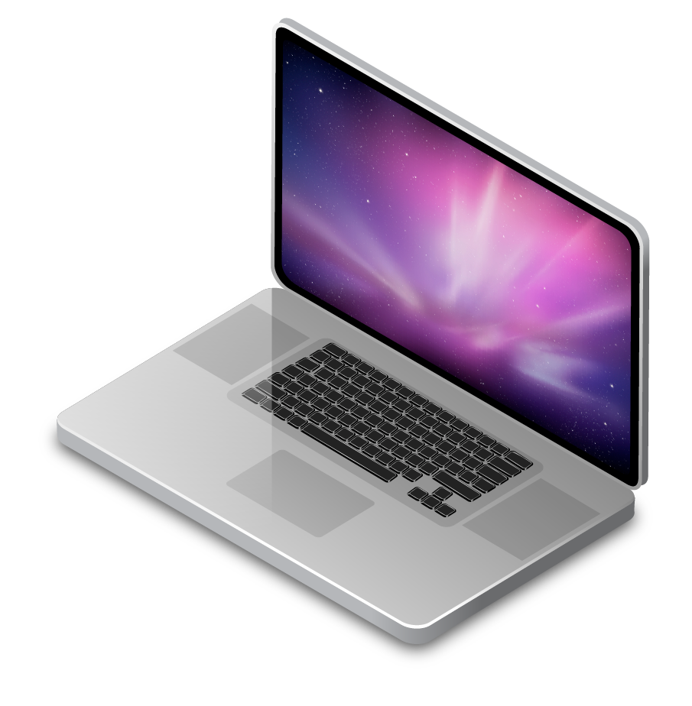
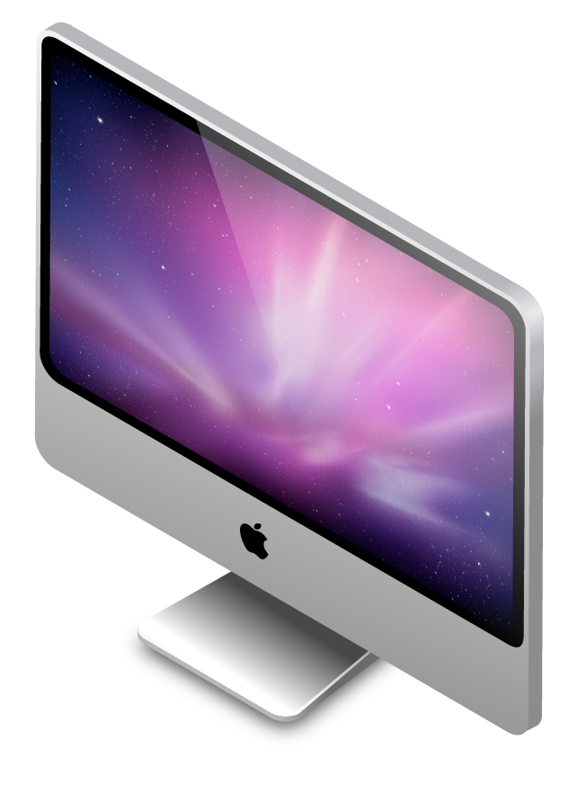
Icons
Android Phone
MacBook
iPad
iMac

Slide 19
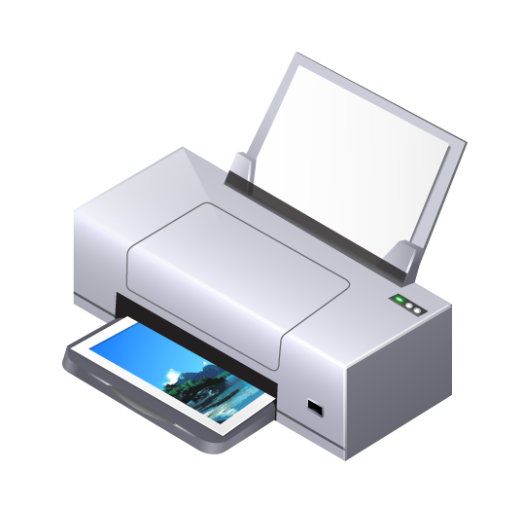
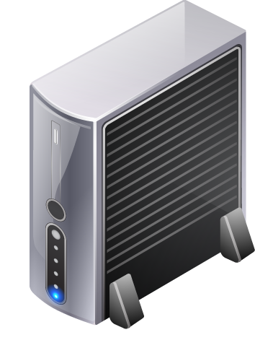
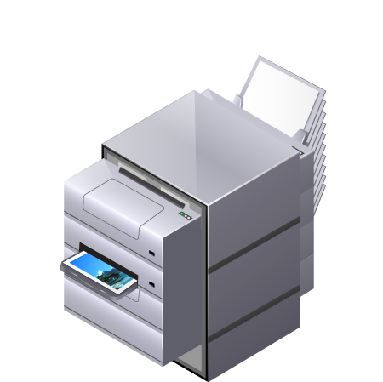
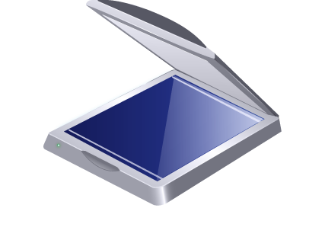
Icons
Home Office
Web Cam
External Hard Drive
Desktop Printer
Scanner
Office Printer

Slide 20
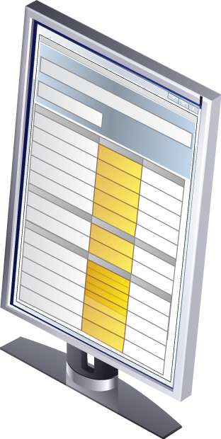
Icons
Widescreen Monitor
VoIP Phone
Vertical Monitor
Multimedia

Slide 21
2-D icons
gear
cluster 1
antivirus
cluster 2
blade server
datacenter
building

Slide 22
2-D icons
datacenter storage
house
ethernet plug
lock
firewall
monitor vertical blank

Slide 23
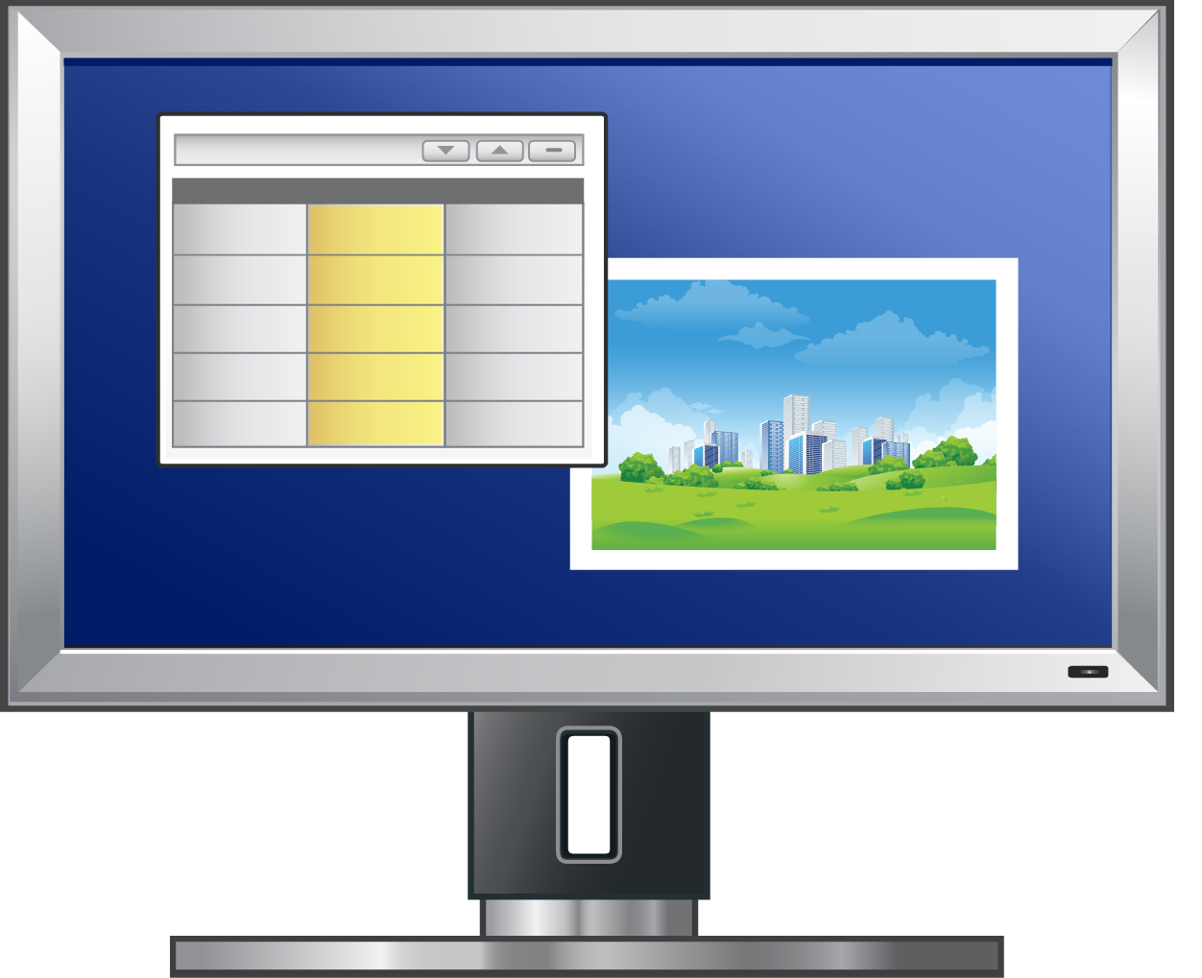
2-D icons
monitor veritcal
PDA
monitor wide blank
script blank
monitor wide
script

Slide 24
2-D icons
shield
storage array
storage
top rack switch

Slide 25
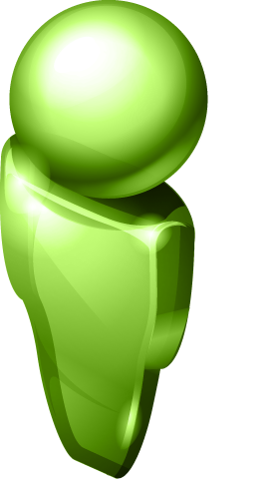
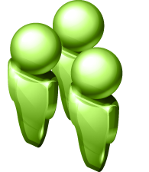
People icons
Person
Check mark
Group / Team
Bar graph

Slide 26
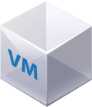
Virtual Machines
Virtual Machine – with virtual desktops
Virtual Machine - basic
Virtual Machine - detailed
Virtual Machine – with virtualized app
Application,Data,OS
Virtualization Layer
ThinApp inside a VM
ThinApp not inside a VM

Slide 27
Flat Versions
Virtual Machine - basic
Virtual Machine – with Virtualized App
THINAPP
Virtual Machine - detailed
Virtualized App inside a VM
Virtualized App not inside a VM
Virtual Desktops
APP
Application,Data,OS
DATA
OS
Editable Text Here
Virtualization Layer
Virtual Appliance

Slide 28
Build Your Own
Editable Text Here

Slide 29
Build Your Own
Any App
Any App
Any App
Insert Any OS
Editable Text Here

Slide 30
Color Palette
Virtualization Layer
Hardware Layer
R: 0
G: 149
B: 211
R: 77
G: 77
B: 77
Virtualization Layer
Virtual Machine
R: 137
G: 203
B: 223
R: 192
G: 192
B: 192
Operating System
Applications
R: 0
G: 61
B: 121
R: 248
G: 152
B: 29
Management Layer
Applications
R: 109
G: 179
B: 63
R: 217
G: 84
B: 30

Slide 31
3D shapes

Slide 32
3D Assets with Editable Text
VM
TEXT
TEXT
TEXT
TEXT
Virtual Machine
App
OS
Data
ThinApp
Formatted Text
Formatted Text
Formatted Text
Virtualization Layers

